Slide 1

Useful open science tools to do research in psychiatry
Thomas Gargot
thomas_gargot@hotmail.com
EPA Congress,
Sunday March 29th

Slide 2
What is your background about Open Science ?

Slide 3






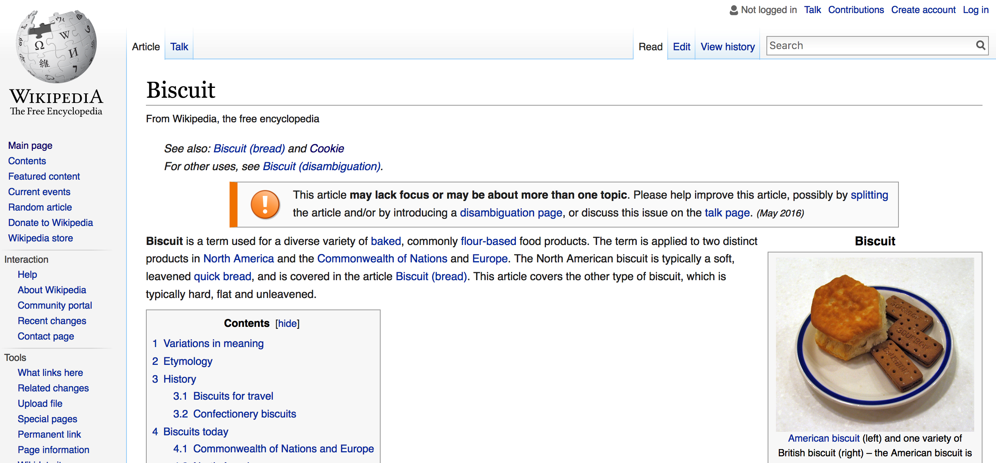
Randomizer.org
Useful open science tools to do research in psychiatry
Collect data
Limesurvey
Analyse data
Share data
OSF and
GitHub
Write an article
Make the knowledge more visible

Slide 4
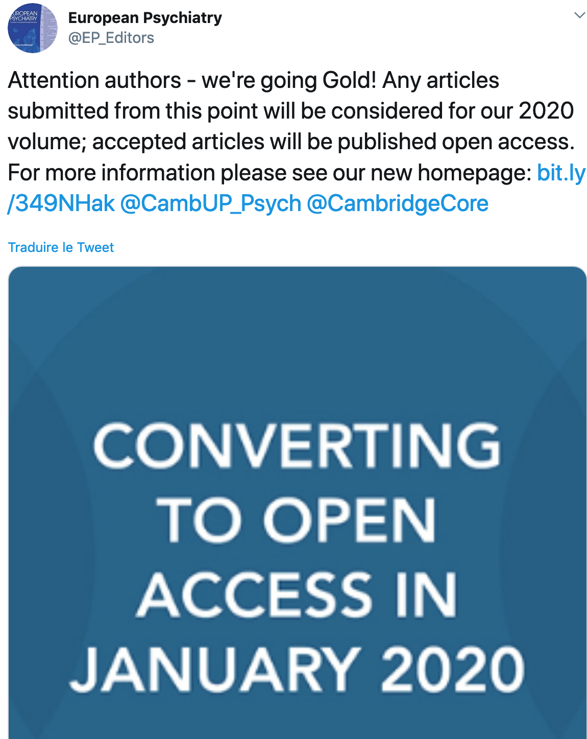
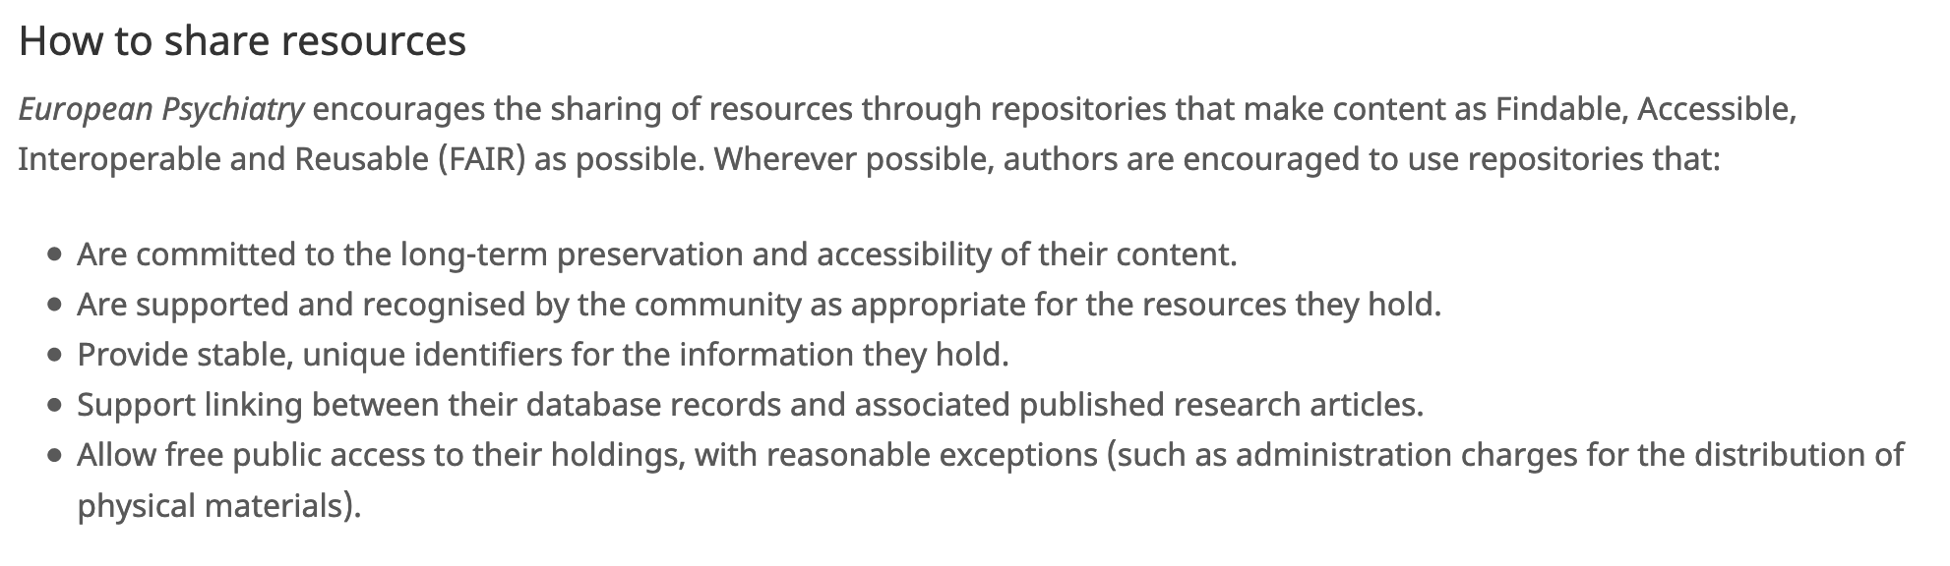
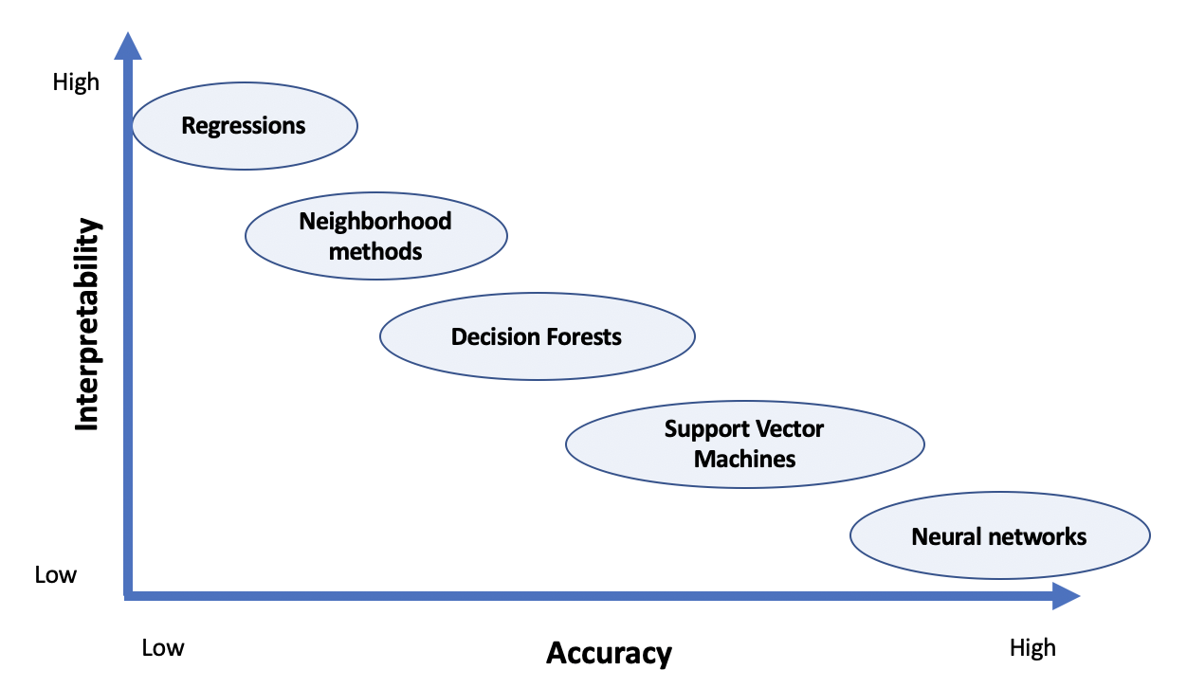
European Psychiatry turns open access
European Psychiatry ask to share data
Psychiatry data can be analysed with a lot of different methods

Slide 5
Goals of the workshop
Understand the challenges of open science
Learn the names of few tools
Consider you own research/projects
Rate cakes

Slide 6



Who I am
Psychiatrist in Paris
PhD Student on Computer Science :
Algorithms and robotic to detect and treat writing learning difficulties in neurodevelopmental disorders
Former IT secretary of EFPT and Psychotherapy WG chairman
Secretary of EPA psychotherapy section

Slide 7
Disclosure
None

Slide 8
Principles

Slide 9
Problems
Cost : How much will it cost to run this study?
Method : What do they mean when they did this analysis?
Licence : Does someone has the last version of this software ?
Memory: where is my data, how to re-use, share it?
Paywall : I can’t get this article
Visibility: Nobody cares about what we did

Slide 10

Publication lucrative vicious circle How the life of publisers changed
Publishers collect articles for free
Paywall and Sell it
Editorial management for free
Reviewing for free
Publishing
(cost decrease)
Research privatization (profit margins approach 40%)

Slide 11

https://www.youtube.com/watch?v=WnxqoP-c0ZE&list=PLKipY1cRnemK1Fn6PbVe5zkOfxLlI02YY&index=6

Slide 12
Goals
Dicrease costs
Improve transparency
Improve accessibility to software, articles, and re-use of data
Improve visibility for public
Is that really possible ?!?

Slide 13
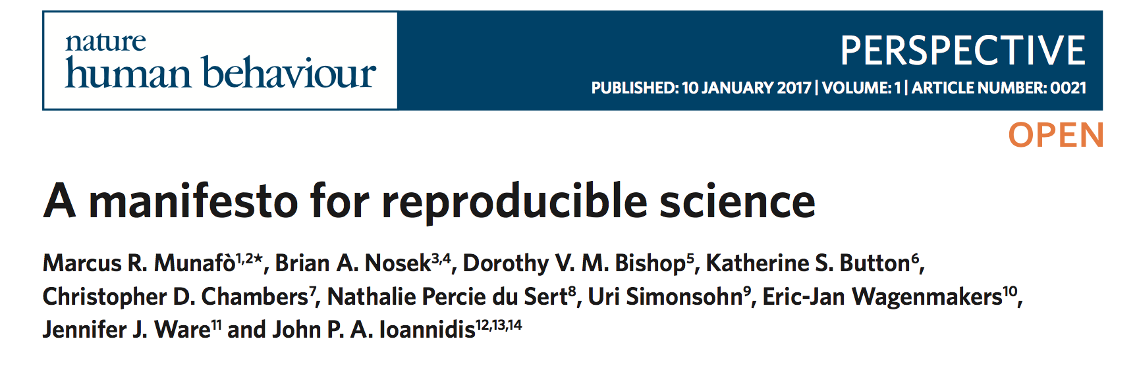
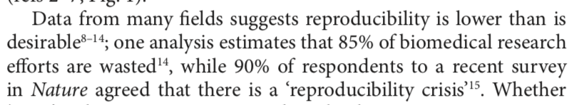
Why is there a need for open science?

Slide 14

Information world
Share of information don’t decrease the ownership of the sharer
Rather, better accessibility improve possibilities of not anticipated use (hacking) and feedback
Open softwares are more flexible and have fewer bugs that closed one (servers, cryptography algorithms)
Notes:
Share physical stuff vs ideas / robust softwares

Slide 15

Free / Open?
Open software: Free use, study, modification, duplication and sharing
≠ Freemium strategy (demonstration)
≠ centralisation and user data collection
https://www.qwant.com/?q=you%20are%20the%20product&t=images&o=0:0a530ac5ad25daeb329762e4a2da88f3

Slide 16
An example of Open science pathway
Hands-on

Slide 17
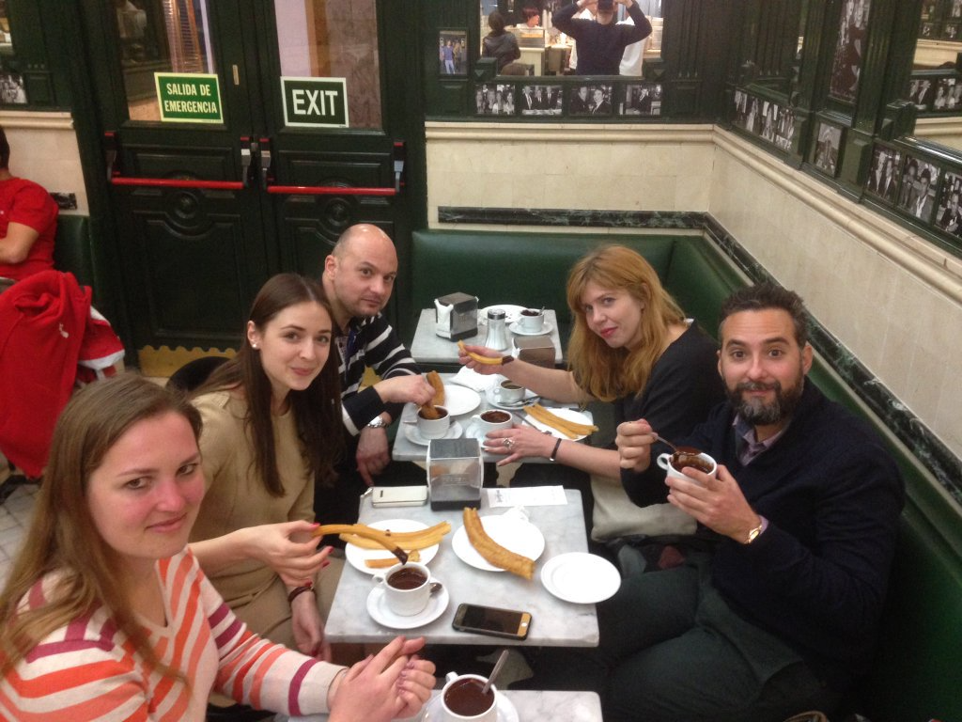
Research protocol
Make a data base of cookies tasting
Rate them in an international context
Select the best cakes in the worlds
Sampling process during EPA congress, Madrid, 2016

Slide 18
Randomizer.org
Useful open science tools to do research in psychiatry

Slide 19
Randomizer.org

Slide 20
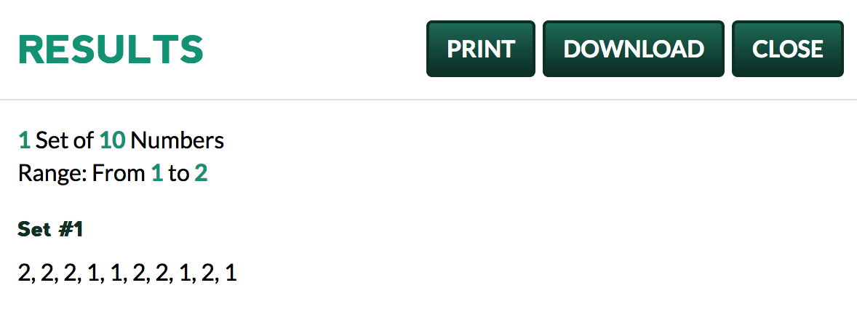
Randomizer.org

Slide 21
Randomizer.org
Useful open science tools to do research in psychiatry
Collect data
Limesurvey

Slide 22

Limesurvey
https://www.limesurvey.org/

Slide 23
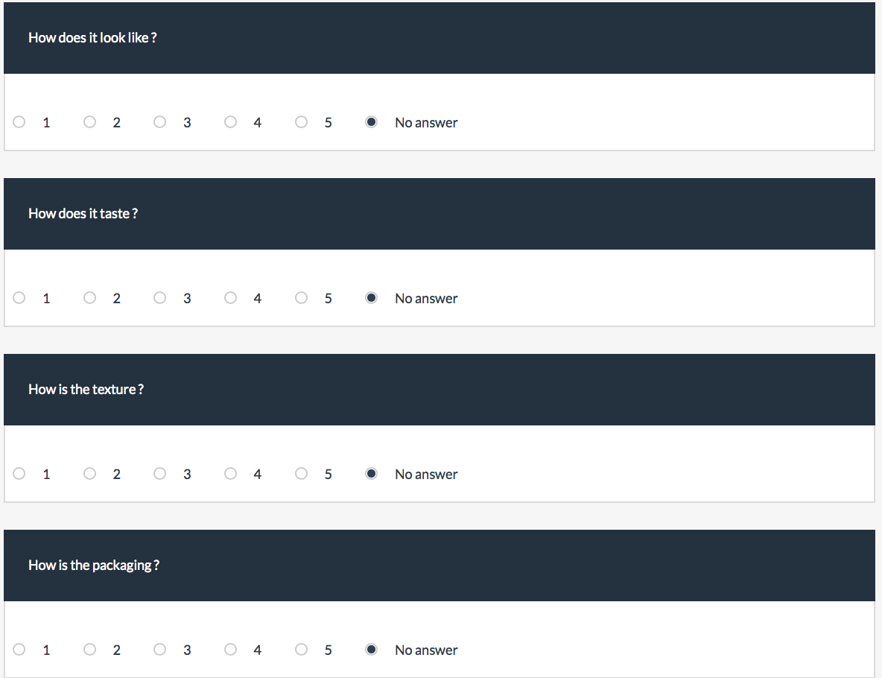

Slide 24
Randomizer.org
Useful open science tools to do research in psychiatry
Collect data
Limesurvey
Analyse data

Slide 25
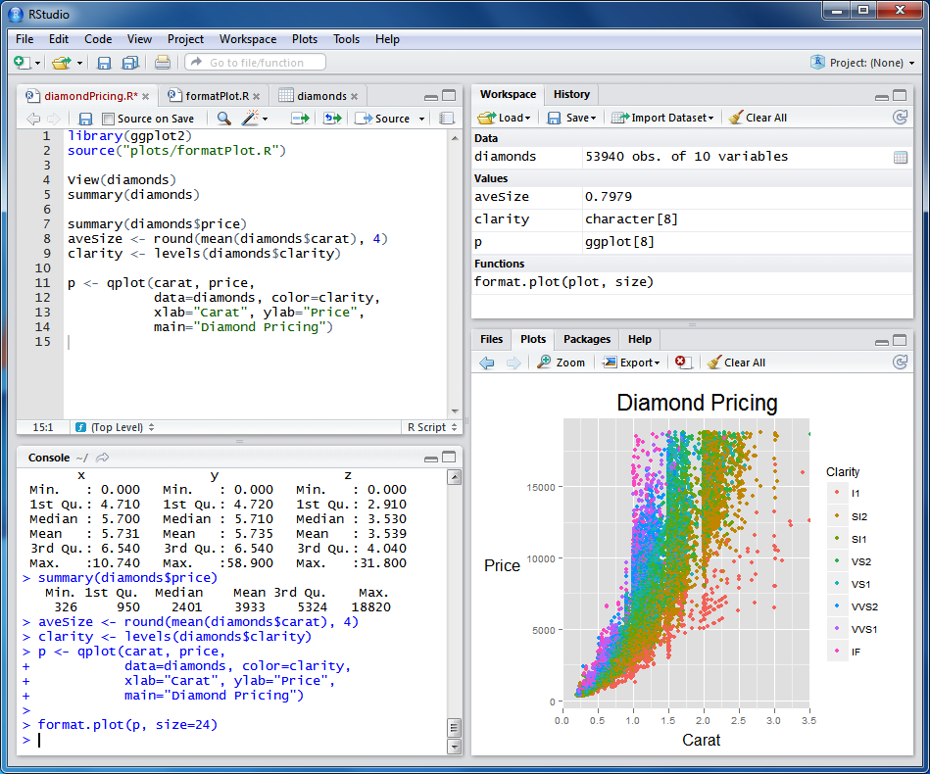

Slide 26
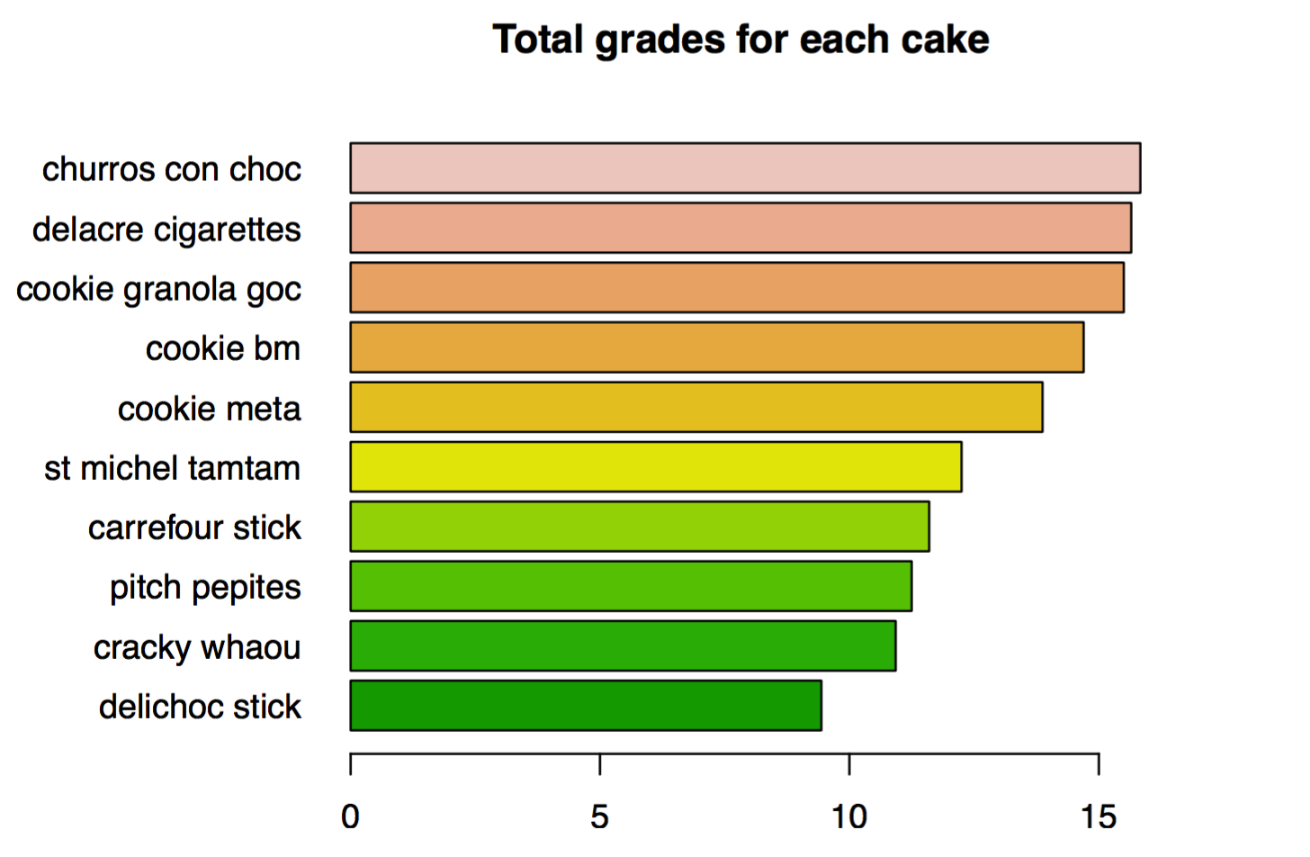

Slide 27
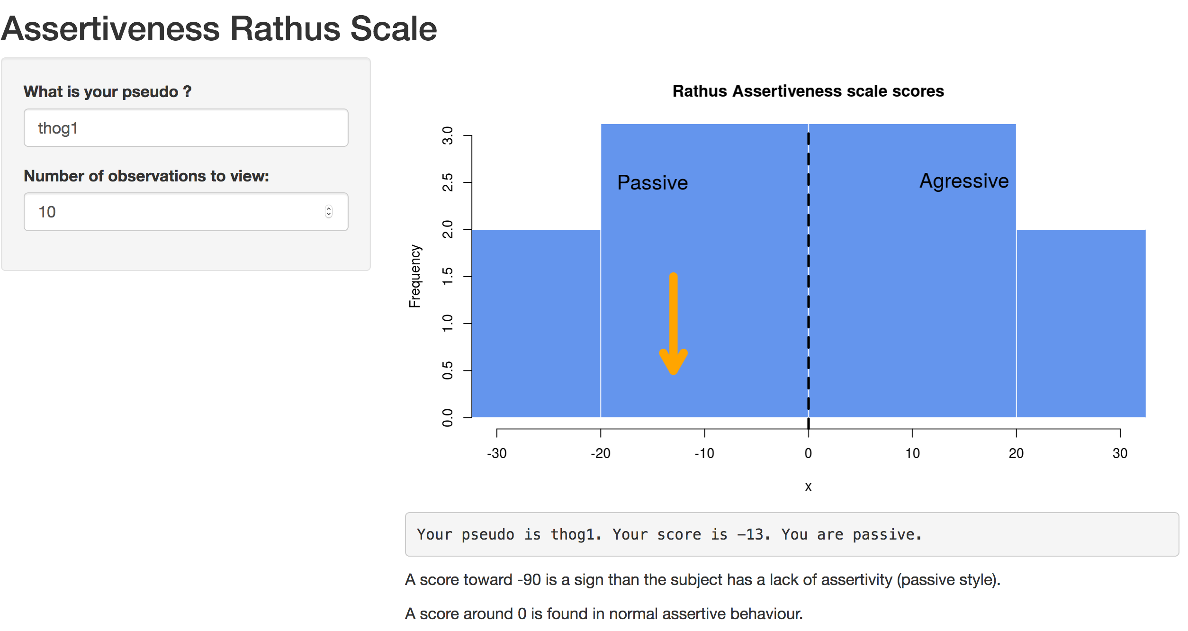
Connect Limesurvey with R ? : Shinyapps

Slide 28


Python
A little more fundamental and less user friendly, very used by computer scientists.
Python has very large possibilities :
collect data during a psychological experiment with pygame
Data analysis
Code a robot
Make a website

Slide 29
Randomizer.org
Useful open science tools to do research in psychiatry
Collect data
Limesurvey
Analyse data
Share data
OSF and
GitHub

Slide 30
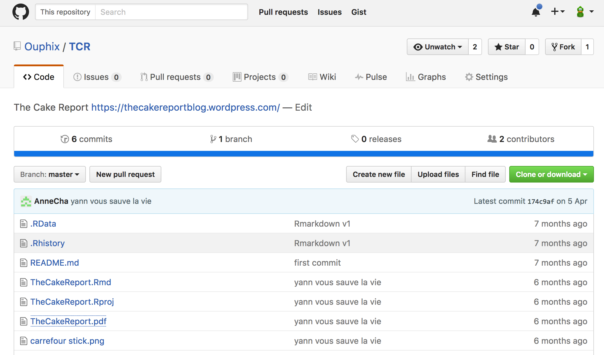
Git Hub
Share data

Slide 31



Slide 32
Randomizer.org
Useful open science tools to do research in psychiatry
Collect data
Limesurvey
Analyse data
Share data
OSF and
GitHub
Write an article

Slide 33
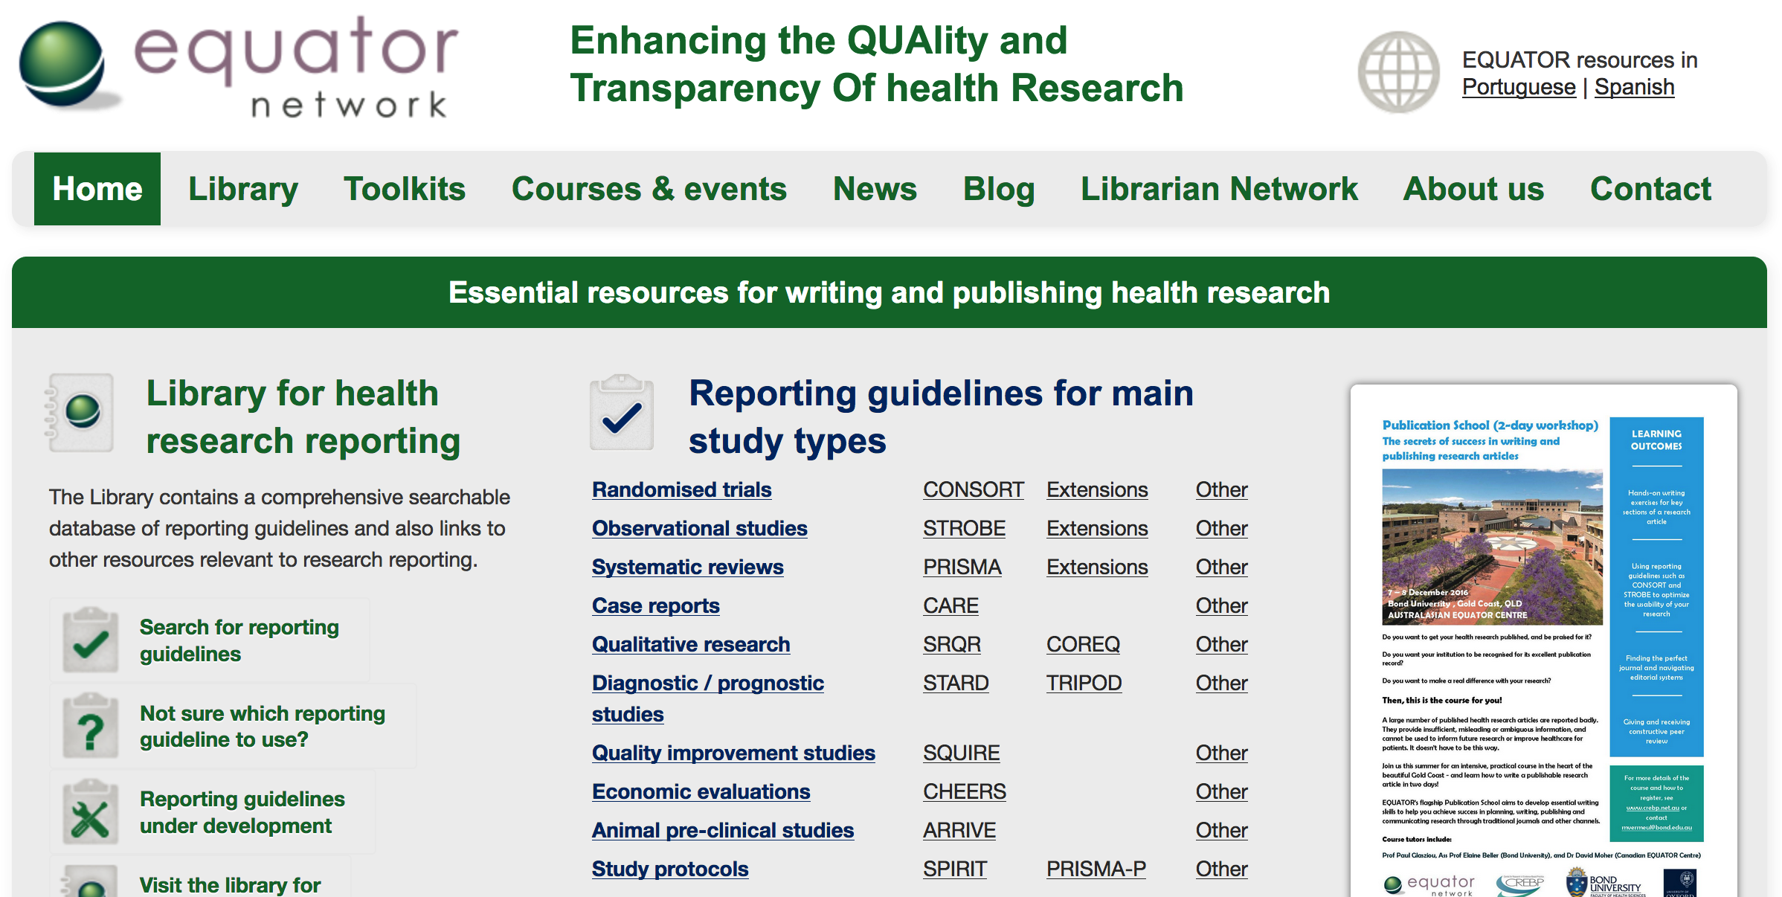
Equator Network

Slide 34
Collaborative writting

Slide 35
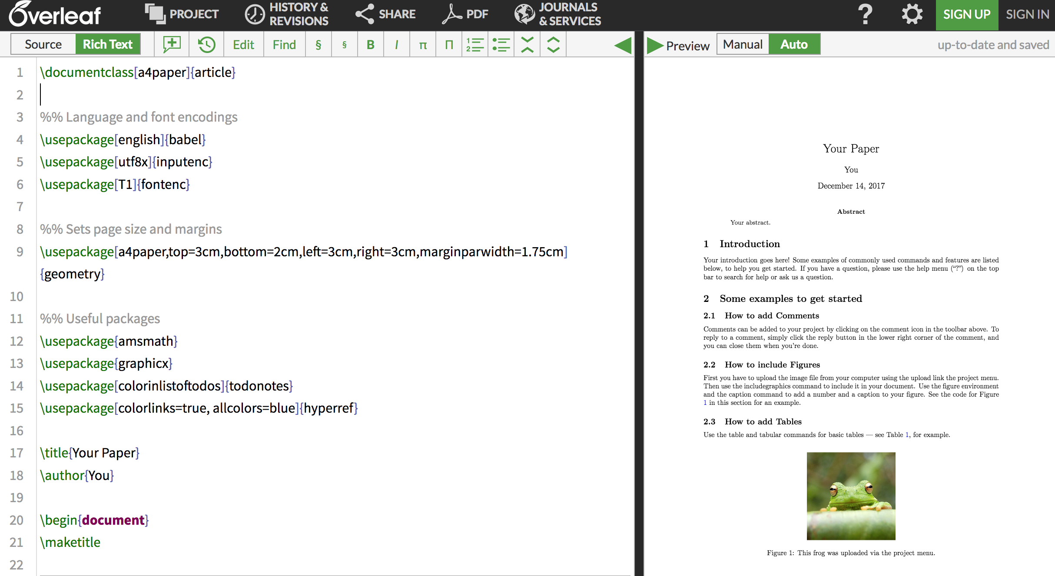

Slide 36
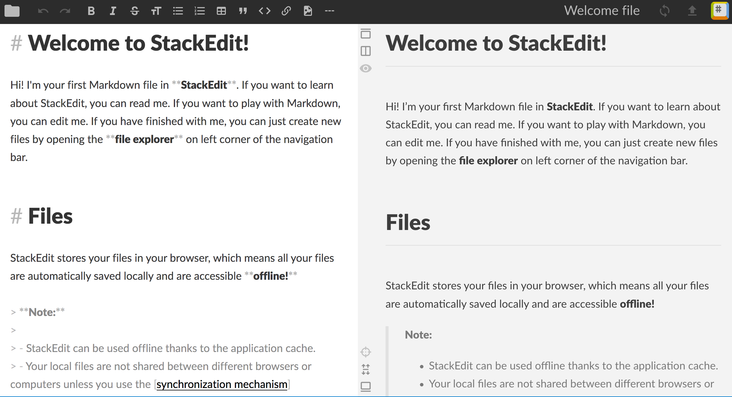

Slide 37


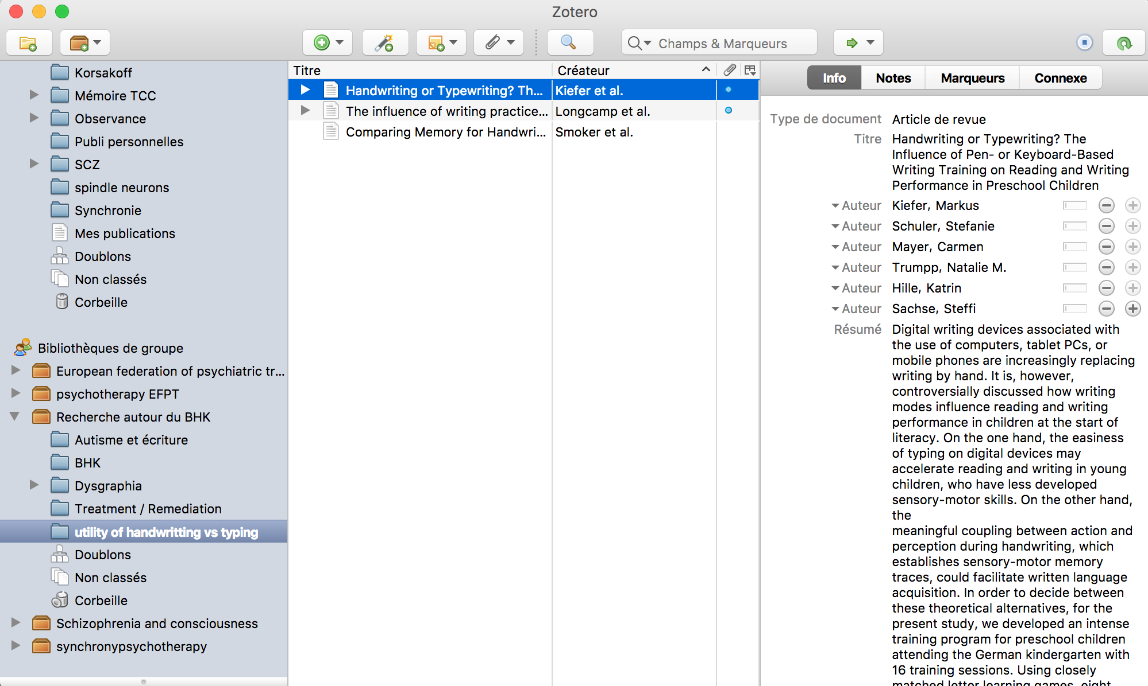
Select, gather, write and share bibliography

Slide 38
New ways to publish ?

Slide 39
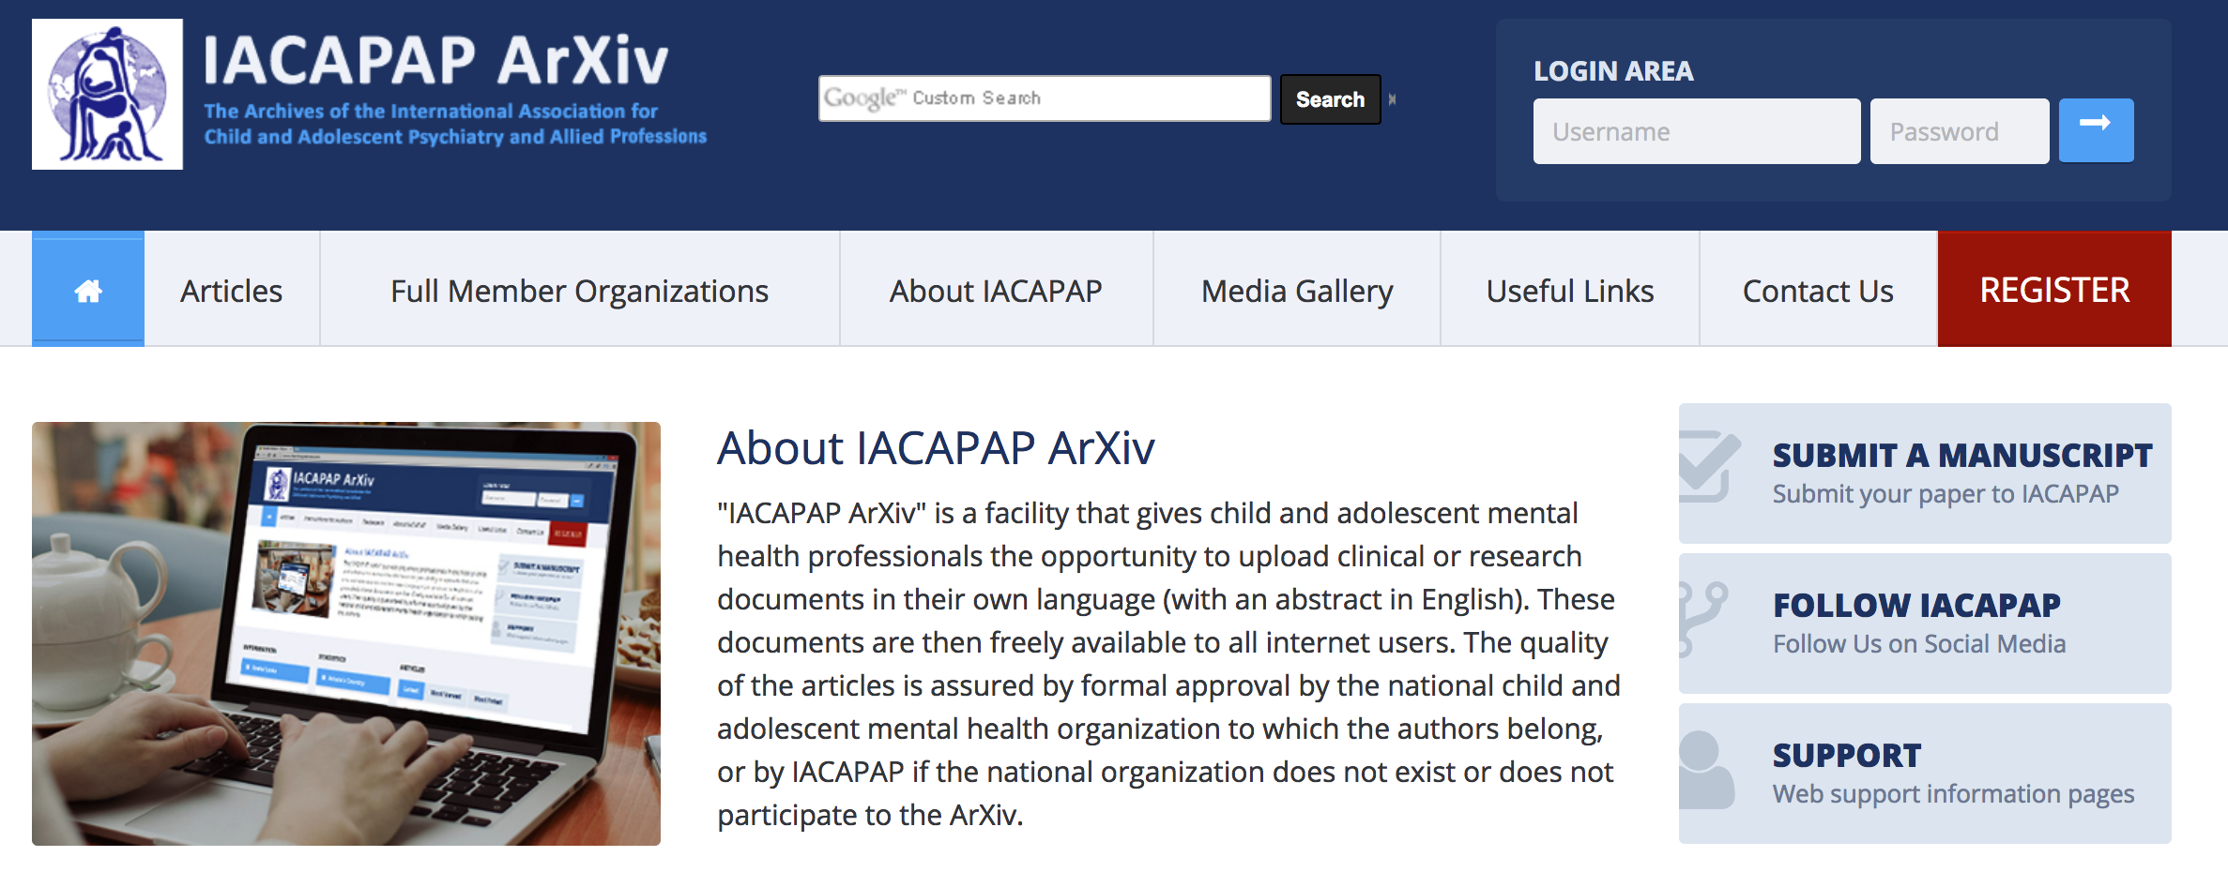



ArXiv : Preprints
Notes:
After review, but before layout: Autor accepted manuscript/ check permissions. Attention cite real publication not archives

Slide 40

https://www.pubpub.org/
Authorea

Slide 41
Share to general public

Slide 42
Randomizer.org
Useful open science tools to do research in psychiatry
Collect data
Limesurvey
Analyse data
Share data
OSF and
GitHub
Write an article
Make the knowledge more visible

Slide 43
https://en.wikipedia.org/

Slide 44
https://en.wikipedia.org/

Slide 45

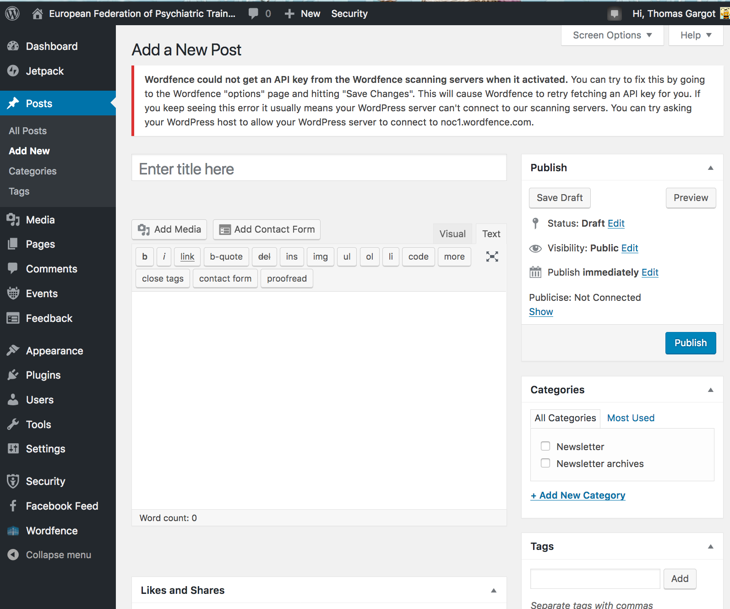
Wordpress

Slide 46
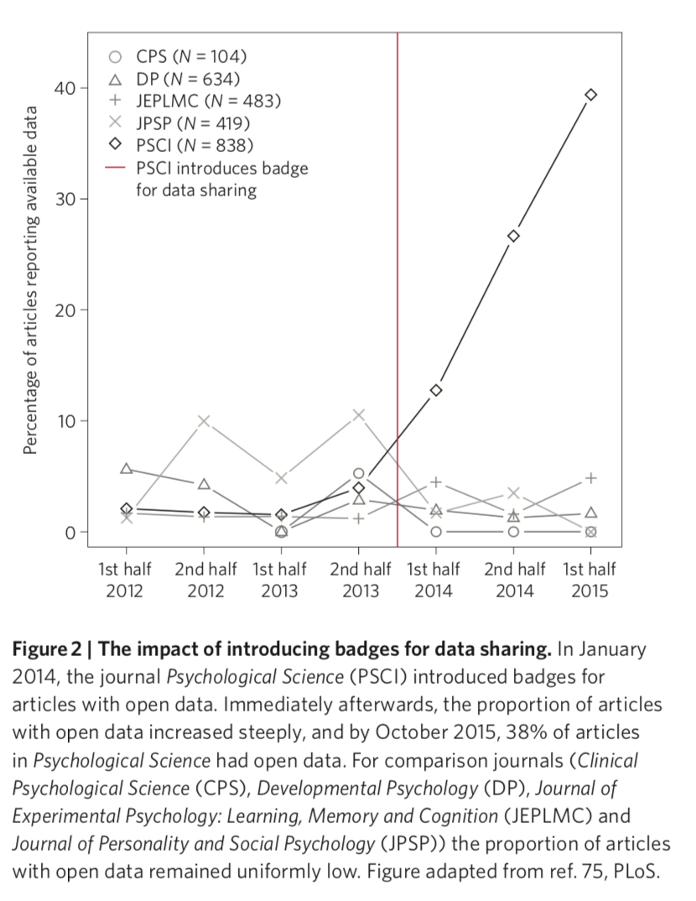



Badges

Slide 47

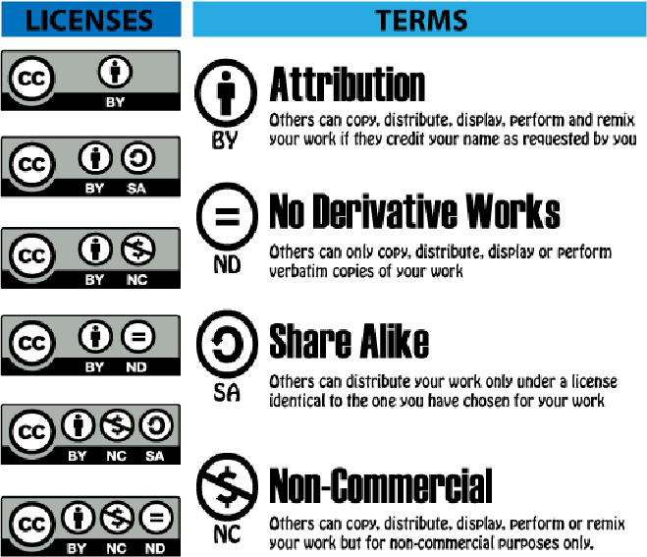
Creative commons

Slide 48
Randomizer.org
Useful open science tools to do research in psychiatry
Collect data :
Limesurvey
Analyse data
Share data
OSF and
GitHub
Write an article
Make the knowledge more visible

Slide 49

Thank you for your attention
thomas_gargot@hotmail.com

